Slide 1

Analysis on price of Laptops based on there features and best recommendations
Presented By
- Dinesh Nakkina
- Ajay Akash Vardhan Thallapudi

Slide 2
About Us
Background –
Both of us have Completed our Master’s Degree in Statistics
Data science is a field that is constantly evolving, and we have a strong desire for continuous learning. Joining this field allows us to stay on the forefront of new technologies and methodologies, ensuring that we are always growing in our knowledge and skills.
Experience –
We are Fresher’s ,we do not have any Experience, but we are eager to bring our analytical mindset, technical skills, and enthusiasm for data-driven problem-solving to a professional setting

Slide 3

Contents
Problem Statement
Tools Used
Raw Data
Web Scraping
Data manipulation /Data cleaning
EDA(Exploratory Data Analysis)
Objective
Conclusion

Slide 4
Problem Statement
How does the distribution of RAM and Storage differ across the laptops, and what insights can be derived from their mean and median values.
How does the distribution of Display differ across the laptops.
How is the Price and Rating Varying in Each Brand.
Finding the Impact of Storage and Display Size on the Price of the Laptops.
Analysing the impact of various features on the Price of the Laptop

Slide 5






Tools used
NumPy
Pandas
Beautiful Soup
Requests
Matplotlib
seaborn

Slide 6
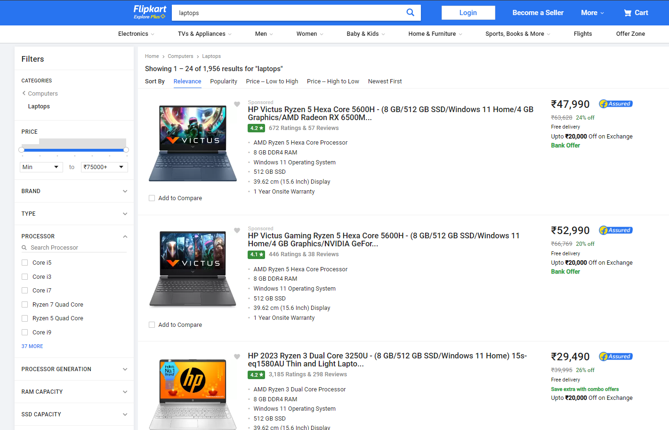
Website

Slide 7
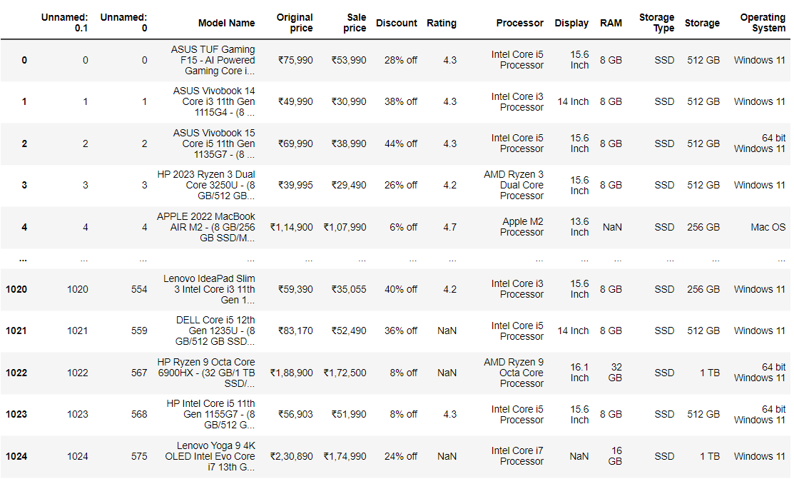
Raw Data

Slide 8

Data Cleaning
Checking for duplicates
Dropping the Duplicates
Checking for Null Values
Filling or Dropping the Null Values
Removing Structural Errors
Data Type conversion

Slide 9
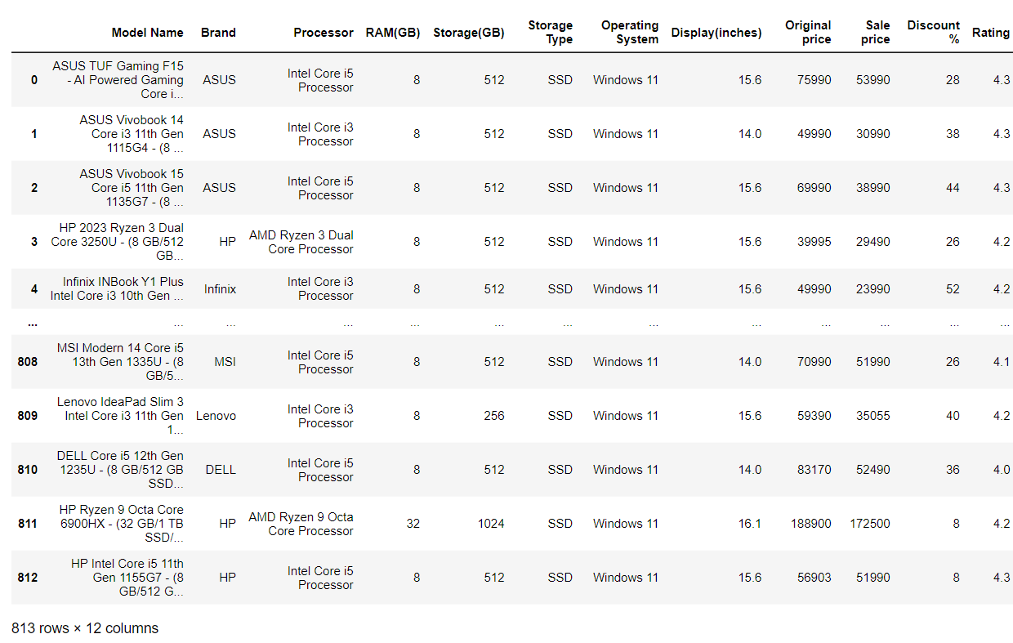
Cleaned Data

Slide 10
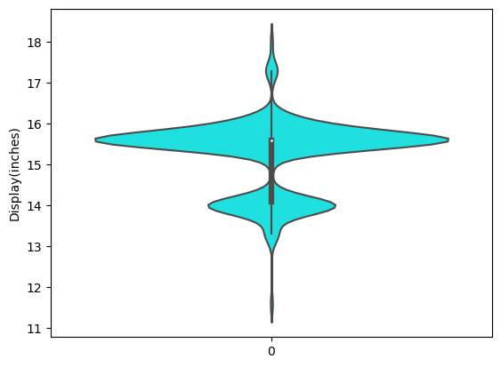
Exploratory Data Analysis
Q) How does the distribution of Display differ across the laptops ?
OBSERVATION:
Here, The width of the violin plot between 15 and 16 indicates the density of data points. A wider section suggests a higher concentration of laptops with that particular display size of 15.6 inches.
The next Hump is at 14,so after 15.6 inches the density of data points is more at 14 inches.

Slide 11
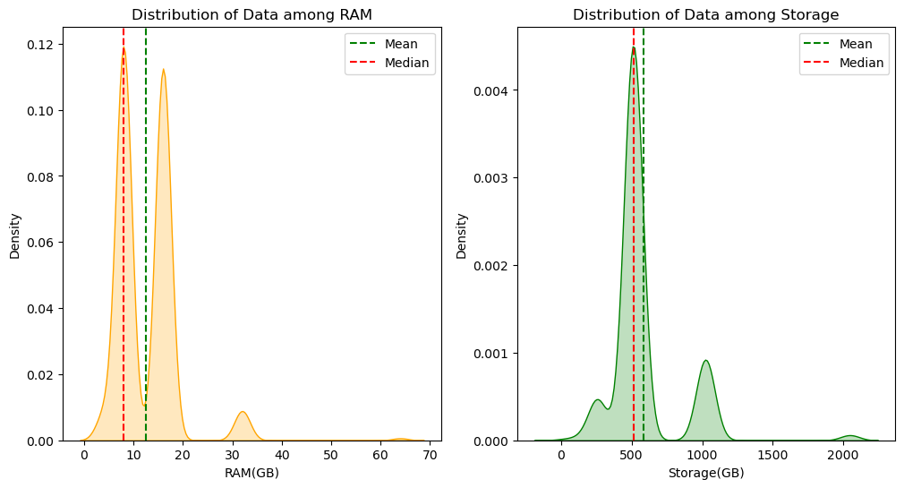
Q) How does the distribution of RAM and Storage differ across the laptops, and what insights can be derived from their mean and median values ?
INSIGHTS:
Both RAM and Storage are positively skewed because the mean > median
In RAM(GB), Data is Distributed mostly among 8GB and 16GB that means these 8GB and 16GB are the most common RAM usage levels.
In Storage(GB), Data is Distributed mostly among 512GB that means 512GB is most commonly preferred Storage.

Slide 12
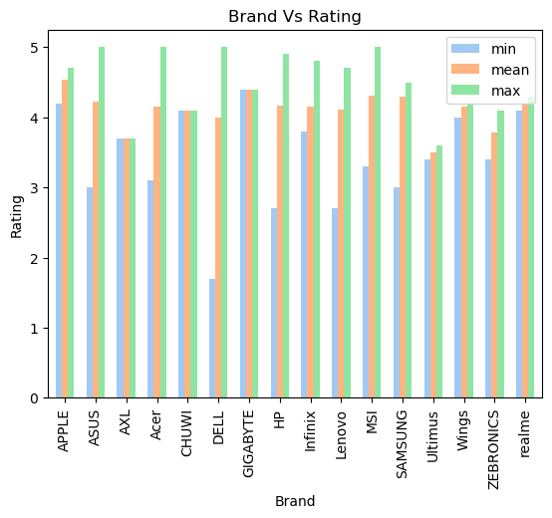
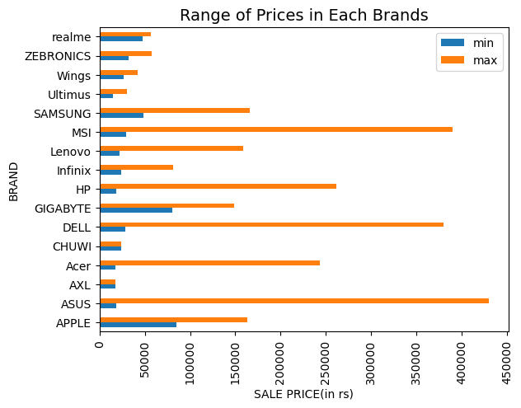
Q) How is the Price and Rating Varying in Each Brand ?
OBSERVATION:
Brands like ASUS,DELL and MSI have wide range of Sale Prices
Brands like APPLE,HP,LENOVO,SAMSUNG have medium range of Sale Prices
OBSERVATION:
Brands like ASUS,ACER and MSI have a narrow range which means more consistent ratings but DELL has more wide range which tells us more diverse user opinions
So we can finally tell that ASUS,ACER and MSI are the brands with high mean ratings and Low variability

Slide 13
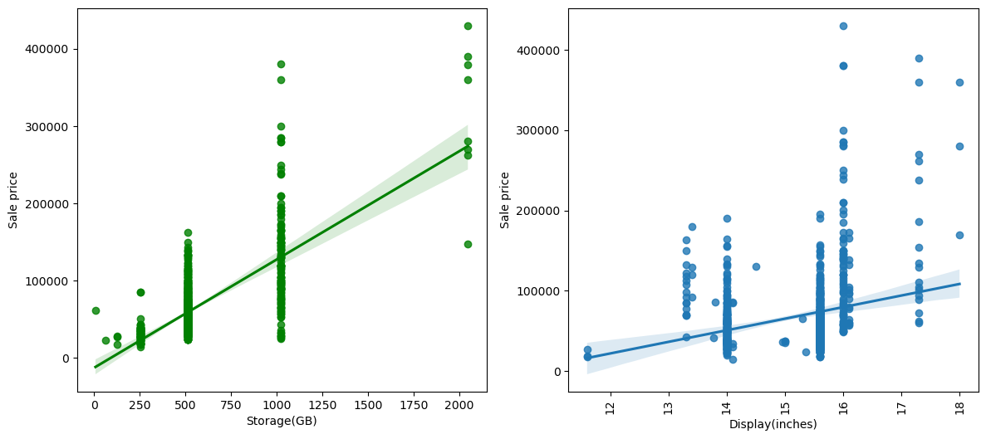
Q) Find the Impact of Storage and Display Size on the Price of the Laptops.
OBSERVATION:
Here, the line slope in Storage(GB) and Sale price is upwards so it is showing a Strong positive correlation
That means , if the storage increases then the Sale price also increases, so it shows a huge impact on the price
The line slope is Display(inches) and Sale price is slightly upward so it is showing a Weak positive correlation
So, we can say Display(inches) does impact on the price but not entirely.

Slide 14
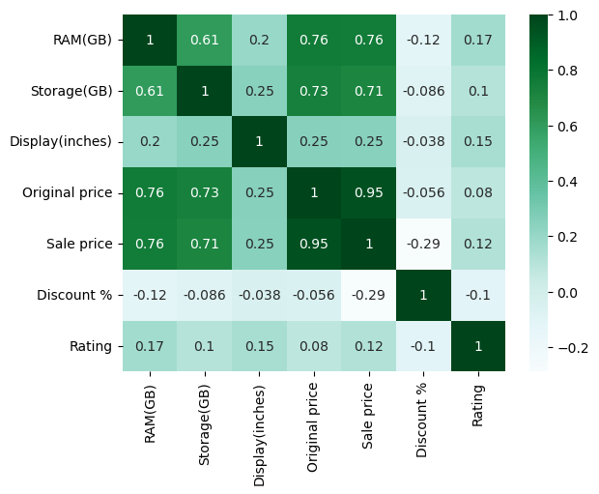
Q) Analysing the impact of various features on the Price of the Laptop
OBSERVATION:
Original price and Sale price are Highly Correlated.
RAM has strong positive correlation with Original price and Sale price
Storage has strong positive correlation with Original price and Sale price
Display has weak positive correlation with the price
Discount has weak negative correlation with the price

Slide 15
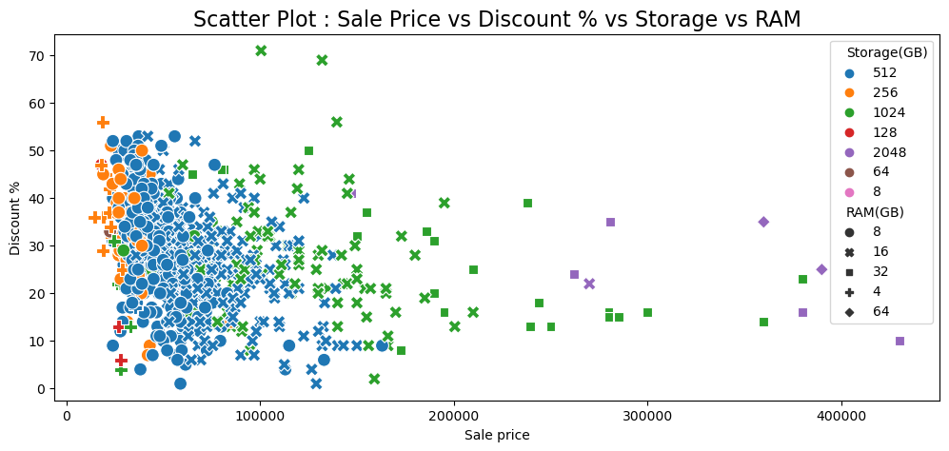
OBSERVATION:
Laptops are mostly with 8GB,16 GB RAM and 512GB Storage
Both RAM and Storage are effecting the Sale price, in other words they have strong positive correlation
We can also observe that most of the Discounts are in the range of 20% to 40%
Most of the Laptops price lies under 1 lakh

Slide 16
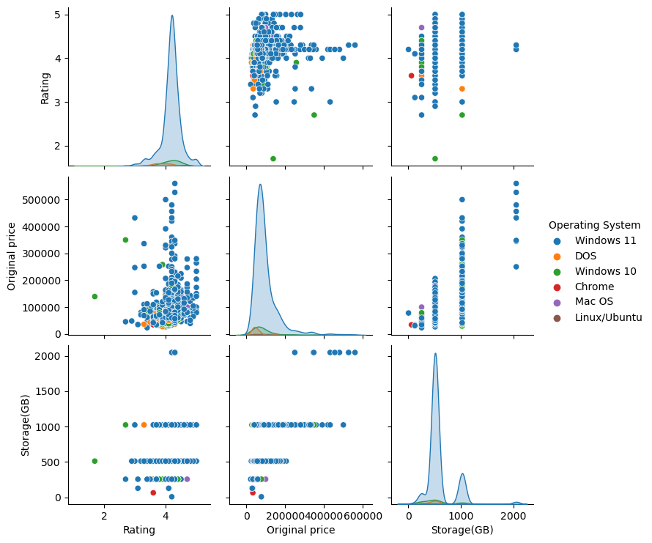
Relation between Original Price, Storage and Rating in Laptops across Operating Systems
OBSERVATION:
Windows 11 Operating System is preferred mostly among the Laptops
Most of the Laptops are rated from 3 to 4.5
Storage is strongly influencing the price of the Laptop

Slide 17
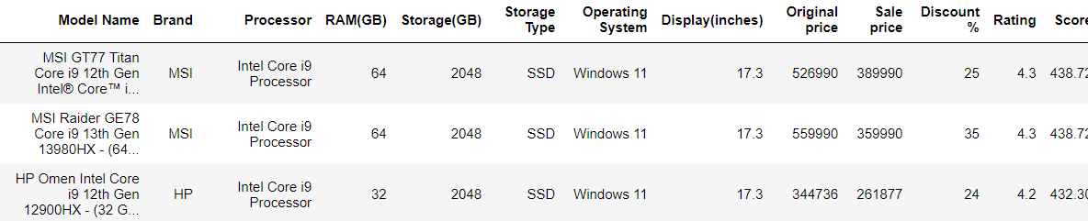
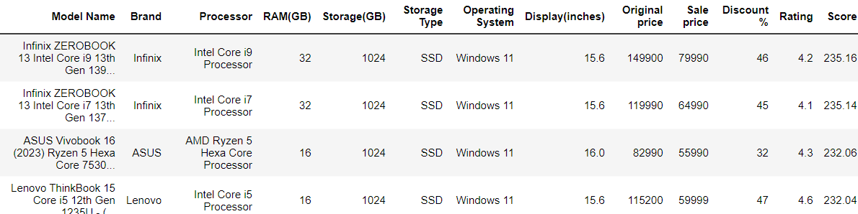
Recommendations
Premium Laptops
Affordable Laptops

Slide 18
Challenges Faced
During the process of web scraping, we encountered numerous challenges when initially attempting to extract the data as the URL is changing continuously .
We had so many duplicates because when dealing with the real time data, data points may be repeated.
However, we have overcomed this Challenge by using container method.

Slide 19
Conclusion
Storage and RAM has huge impact on the Laptop Price
Most of the Laptops comes with Windows as Operating System
Most Production of Laptops are of 16gb RAM and 512gb SSD, so we can say that these are the most common RAM and Storage Levels.
So If you want to buy a laptop, the above
On the basis of Ratings, DELL has wide range of user opinions and ASUS,MSI and ACER has best average ratings.
Best Premium Laptops,
1. MSI GT77 Titan, MSI Raider GE78
2. HP Omen Intel Core i9 12th Gen 12900HX
3. ASUS ROG Zephyrus Duo 16
Best affordable Laptops,
1. ASUS Vivobook 16 (2023) Ryzen 5
2. Infinix ZEROBOOK 13
3. Lenovo ThinkBook 15

Slide 20

THANK YOU

